Slide 1


Why Scrum?
Calvin Cottman

Slide 2


The Agile Manifesto
To understand the proper practice of SCRUM, we must first understand the agile manifesto.
Agile is a project management methodology that focuses on continuous improvement and adaptivity.
"Individuals and interactions over processes and tools Working software over comprehensive documentation Customer collaboration over contract negotiation Responding to change over following a plan
That is, while there is value in the items on the right, we value the items on the left more."
(Cunningham, 2001)
The agile methodology is a slight contrast from the traditional waterfall methodology of project management.
This Photo by Unknown author is licensed under CC BY-SA.

Slide 3
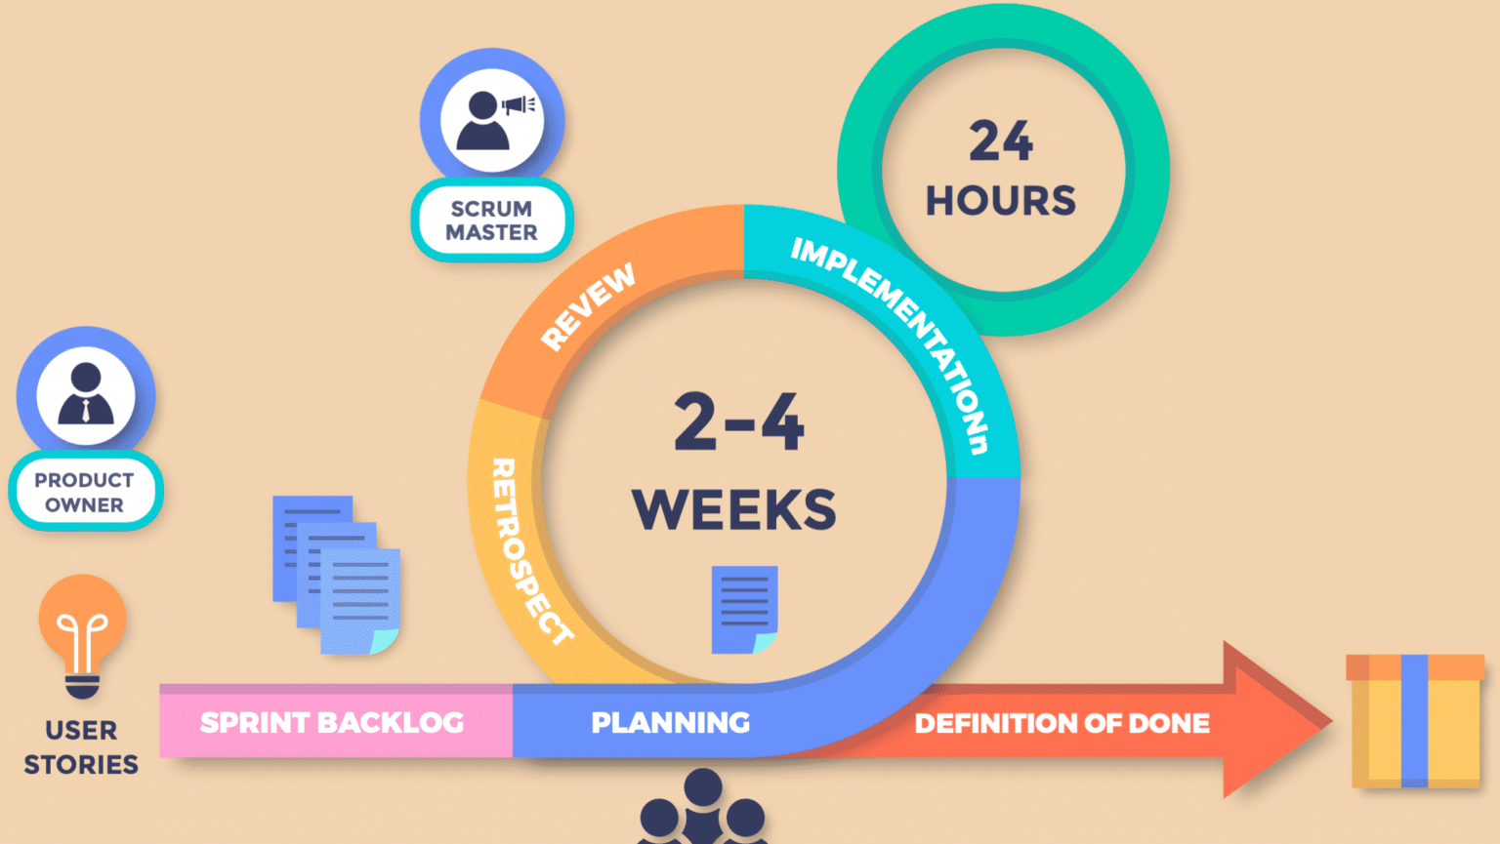
Scrum
Figure 1
"Scrum has become rapidly accepted as the most widely used methodology in the United States and its usage is rapidly expanding in other areas of the world as well."
(Cobb, 2015)
(Ackerman, 2021)
Scrum is a framework for managing complex projects, based on well defined roles. These roles are as follows:
Scrum Master
Product Owner
Development Team
A high level of the scrum framework is shown in figure 1 above. Scrum is based on sprints, or a fixed length of time where the development is done. Projects are typically broken up into smaller increments that can be finished inside of a sprint.
Scrum also consists of a product backlog, or sprint backlog which is essentially a queue of work to be done that is well organized by the product owner. The product backlog is not final, meaning changes will be made continuously as more information is learned by the team; scrum is meant to be dynamic. These factors can be determined during the development process but also are improved upon during the planning process.
The planning process in scrum is not just a one and done process. Before each sprint there is a sprint planning that takes place. In the initial spring planning process, the group determines how to break the project into sprints. Once this happens, sprints can take place. Before each sprint there is a planning process for that sprint.
Another big aspect of planning is the daily scrum meetings, or daily standup. The scrum team will meet daily, preferably standing to keep meetings short and focused. Everyone in the team typically answers three questions.
“What did you accomplish yesterday?”, “What are you going to accomplish today?”, and “What is impeding you?”. This process keeps communication sharp within the team.

Slide 4

Review and Retrospective
This Photo by Unknown Author is licensed under CC BY-SA-NC
At the end of each sprint, the team presents their work to the product owner and review the work done. This is not the first time that the team would demo their work throughout the sprint but rather the final time. Defects are to be fixed during the sprint as the team develops alongside a tester who is part of the development team. Any big changes determined by the product owner may be added to the sprint backlog for future sprints otherwise the review stays in line with the original sprint goal. It is common practice for stakeholders to be present at the sprint review.
Not to be confused with the sprint review, there is also a sprint retrospective held at the end of each sprint. This is an opportunity to look back on and discuss lessons learned in the sprint. This is a chance to continuously improve the process for future sprints. Because the nature of scrum is to be adaptive, this process is very important. This should help the team have more of a proactive approach as opposed to a reactive approach to their project.
Sprint Review
Sprint Retrospective

Slide 5

The Product Owner
“The Product Owner (PO) is a member of the Agile Team who is responsible for maximizing the value delivered by the team and ensuring that the Team Backlog is aligned with customer and stakeholder needs.”
(Scaled Agile, 2022)
The product owner is largely responsible for the customer interactions and product backlog, which sets the roadmap of the project. Though the product owner is not the only one that can talk to the customer and will be interacting with the customer, that is their focus. They will work closely with the customer to develop a backlog that both the team and customer can agree on. They are responsible for ordering the backlog as well. This role is very important in keeping the development process as transparent as possible. Keeping the process transparent helps to eliminate any uncertain details of the project or any surprises at the end of the project. The customer should know almost everything the team knows at every step and work with each other as opposed to giving requirements and hoping they are met by a specified time frame. The product owner is also in charge of creating user stories, which are the goals to be met within the project separated into “sprints”, or increments.

Slide 6

Scrum Master
“The Scrum Master is accountable for the Scrum Team’s effectiveness. They do this by enabling the Scrum Team to improve its practices, within the Scrum framework.”
(Scrum.org, 2022)
This Photo by Unknown Author is licensed under CC BY
The scrum master is responsible for coaching the team members in self management and cross functionality. This is important in scrum because there should be no real leader, and everyone should consider themselves an equal part and take responsibility for their work as a team and not as individuals. A scrum master is also responsible for helping the team focus and removing and impediments the team may be facing. The scrum master does not only serve the development team but also the product owner in helping the owner find techniques to effectively convey goals and manage the product backlog. The power of scrum is in the scrum master’s hands and it important that this person makes sure scrum is understood and enacted. The scrum master must be able to facilitate the team through meetings and organization.
“not all teams are at [the idealistic] level of maturity, and some level of leadership is needed. The Scrum Master has to really “fill the cracks” to fit the situation”
(Cobb, 2015)

Slide 7

The Development Team
“The Development Team consists of professionals who do the work of delivering a potentially releasable increment of “Done” product at the end of each Sprint. Only members of the Development Team create the increment.”
(Cobb, 2015)
The development team is the team responsible for
the development process. Though the scrum team is
split into many different roles, keeping the
project scrum includes making sure the development team is cross trained in their roles. It is important that everyone is capable of doing the development needed. It is encouraged that individuals may specialize in a particular role and that individual will be responsible for such a role. One important aspect of the development team is that no individual will take credit for anything done. The team is accountable for the work done as a whole. The goal is for everyone to work together in their different positions at a well coordinated pace.
This Photo by Unknown Author is licensed under CC BY-NC-ND

Slide 8
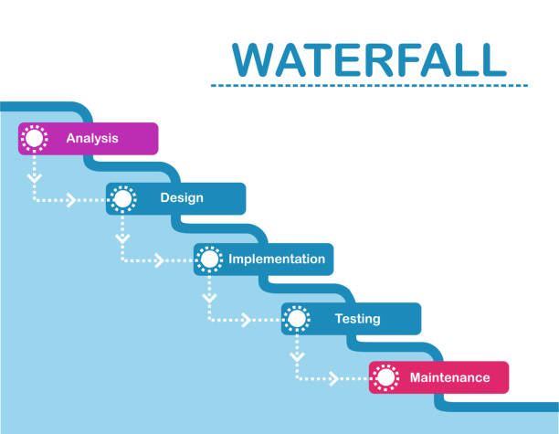
The Waterfall Model
The waterfall model is a traditional software development model with distinct goals at the end of each phase.
"Often considered the classic approach to systems development lifecycle, the waterfall model describes a development method that is linear and sequential."
(Cobb, 2015)
Waterfall is driven by planning and detailed requirements. Once a phase of development is finished, there is no turning back and the project moves on to the next phase.
(Sylfide, 2019)

Slide 9

Waterfall vs Agile
Waterfall
Agile
Sequential plan driven approach
Substantial amount of planning is required before starting the beginning the project
Cost of project can be defined early in planning
Communication with stakeholders is at a minimum
Not a transparent process between developers and stakeholders
Adaptive continuous improvement approach
Planning is saved for last responsible minute without impacting project (rolling wave planning)
Cost of project may not be clear in early planning
Communication with stakeholders is present throughout the project
Transparent process with developer and stakeholders working with each other

Slide 10

Which is better?
You may be asking now "which methodology is better, and why?". That all depends on many factors. When your project is predictable and has strict requirements, then waterfall may be the way to go. If your project does not necessarily have strict guidelines, then agile is the way to go. If you are on a fixed timeline , or you are working on an existing project, then again, waterfall is the way to go. If not, then agile is the way to go. There are many other factors that can contribute to your decision. Ultimately in a software development environment, agile is the better of the two methods to use due to the nature of creating new software. It allows for teams to be more interactive amongst themselves and the stakeholders. It also allows for a great level of transparancy while developing a project between the customer and development team.
This Photo by Unknown author is licensed under CC BY-NC-ND.

Slide 11
References
Cobb, Charles G. (2015) “The Project Manager's Guide to Mastering Agile : Principles and Practices for an Adaptive Approach”
https://web-s-ebscohost-com.ezproxy.snhu.edu/ehost/ebookviewer/ebook/bmxlYmtfXzkzNzAwOV9fQU41?sid=be3da416-08c2-46ad-b42f-9b57f4c80ff6@redis&vid=0&format=EB&lpid=lp_1&rid=0
Ackerman, Stacey (2021) “Figure 1”
https://martech.org/what-is-scrum-the-project-management-framework-agile-teams-rely-on/
Scaled Agile (2022) “Product Owner”
https://www.scaledagileframework.com/product-owner/
Sylfide(2019) “Waterfall development process”
https://www.istockphoto.com/vector/waterfall-development-process-gm1166595589-321165612
Scrum.org (2022) “Learn About the Role of the Scrum Master”
https://www.scrum.org/resources/what-is-a-scrum-master

